Slide 1

Resolution Enhancement of Image Project (REIP)
DIRECT Program
Team member: Hsuan-Yu Chen, Chi Wei Lin , Ren-Mian Chin, Chia-Ying Yeh, Changyou Leu.
Date:15/3/22
Advisor: Prof David Beck & Stéphanie Valleau

Slide 2
Background
DIRECT Program
Many new coming graduate students aren’t familiar in using microscope, such as SEM, TEM etc. A common question for them is hard to judge the quality of microscopic image, or have no way to fixing the image.
We decided to develop a software to distinguish whether the image is with surface charged, blurred, etc. Moreover, It will try to restore the image and provide suggestion for the student to improve their shooting technique.

Slide 3
Technologies
DIRECT Program
CNN (Convolutional Nertal Network)
Classify the images by their quality for classification
OpenCV, pillow, inpaint_biharmonic()
Improve the resolution of the image
Remove the damaged part
Imaging processing technique (img-processing, enhance_detail, EDSR^{[1]}, ESPCN^{[2]} , FSRCNN^{[3]}, LapSCN^{[4]} )

Slide 4
CNN
DIRECT Program
Training parameter :
#hyperparamters
nclasses = 3
nchannels = 3
imagesize=(300,300)
batchsize=20
epochs=20
Total number of picture:
Clear:500
Blur: 500
Surface charge: 400
Total = 1400
picture distribution:
80% total image =1120
Train:896
Validation:224 (80% of train)
Test:280 (20% of total image)
Basemodel:
densenet121
Low file size
Fast
Accuracy ~88.57%
Validation accuracy ~88.18%

Slide 5
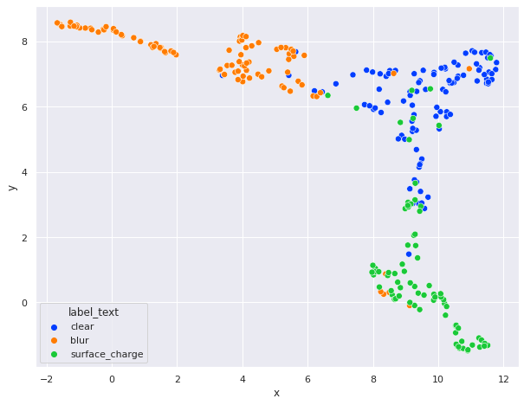
CNN
DIRECT Program

Slide 6
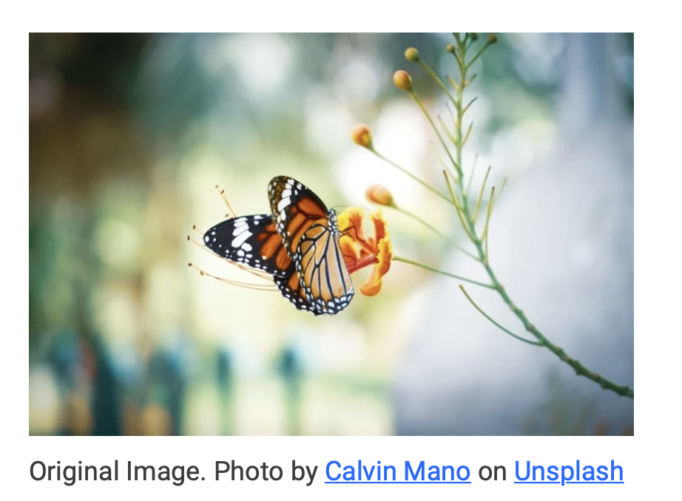
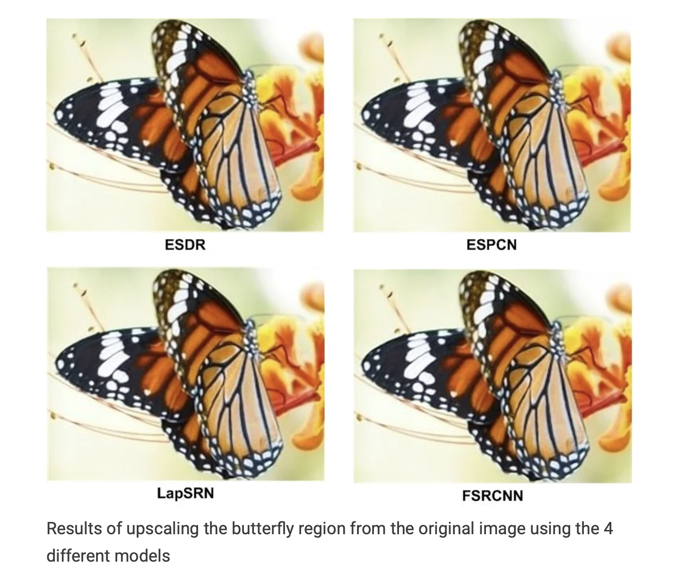
DIRECT Program
https://learnopencv.com/super-resolution-in-opencv/

Slide 7
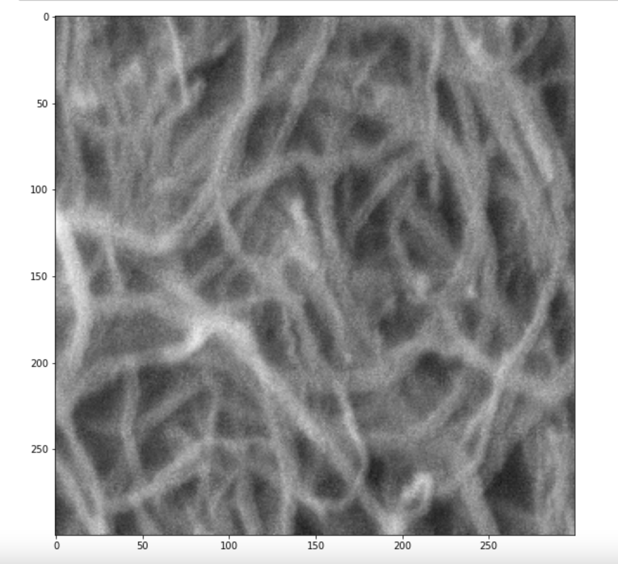
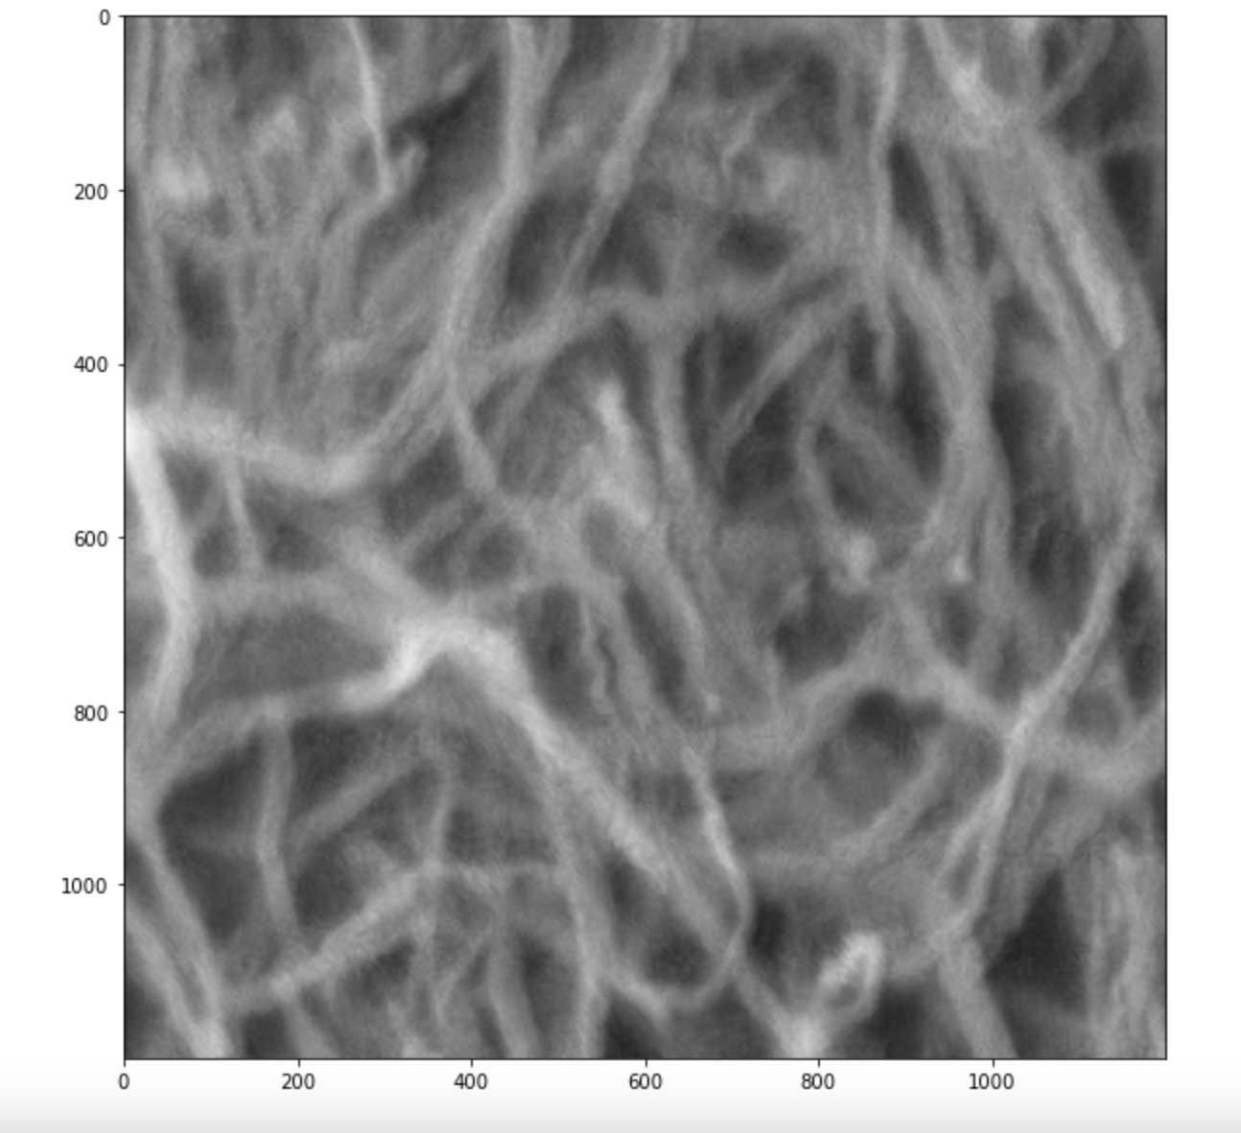
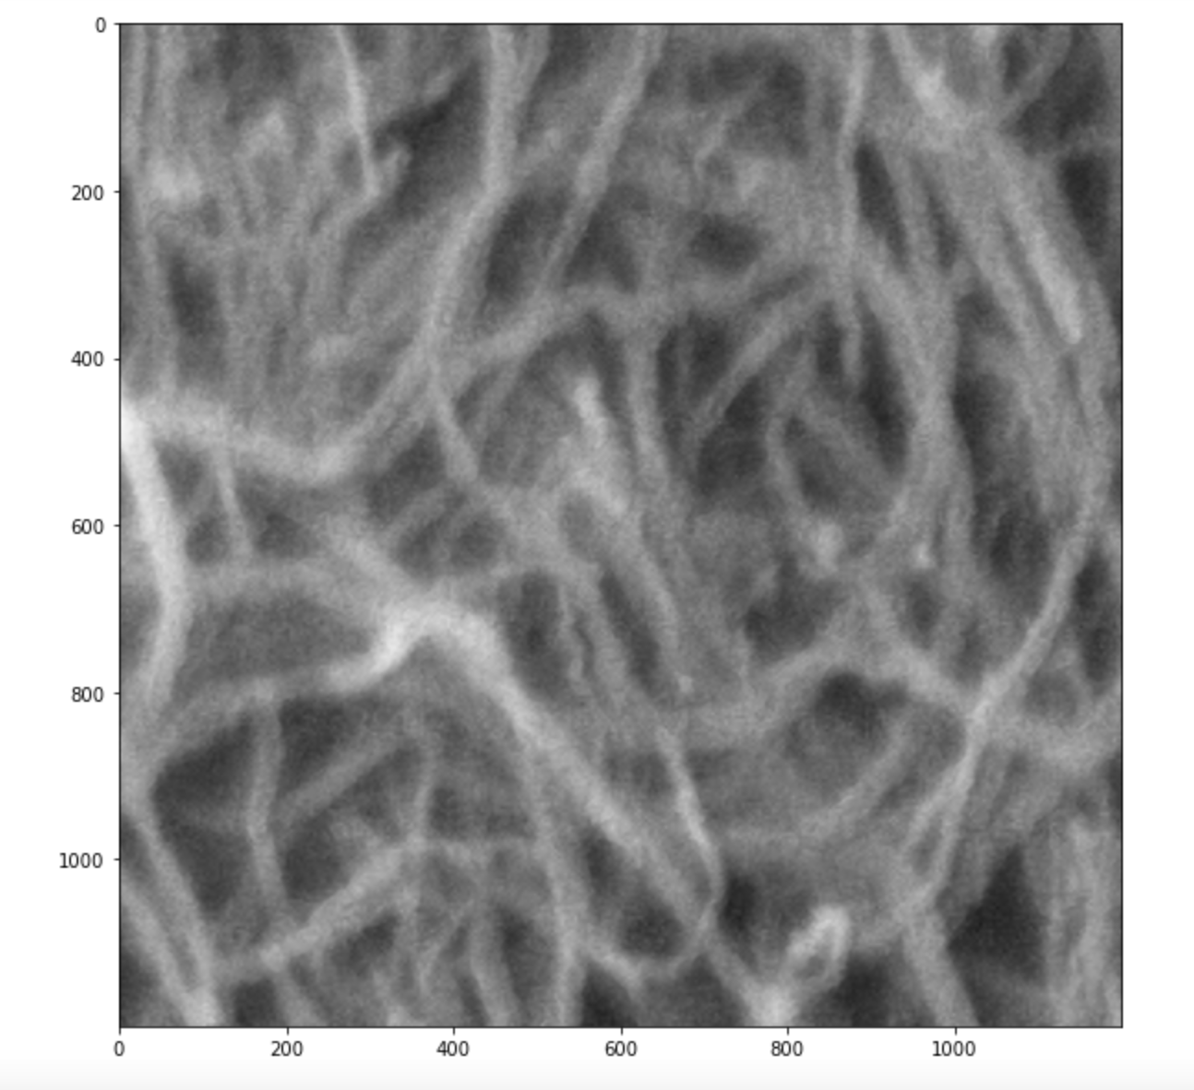
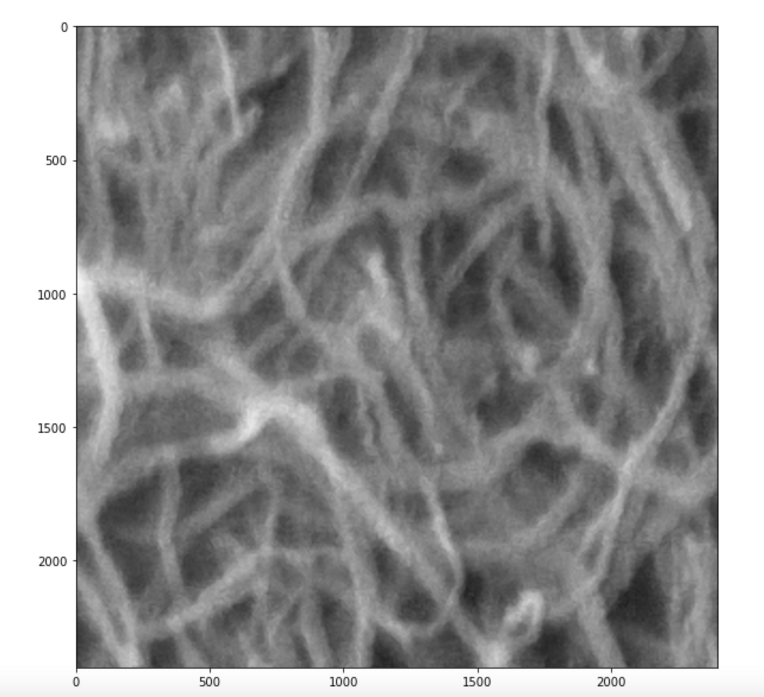
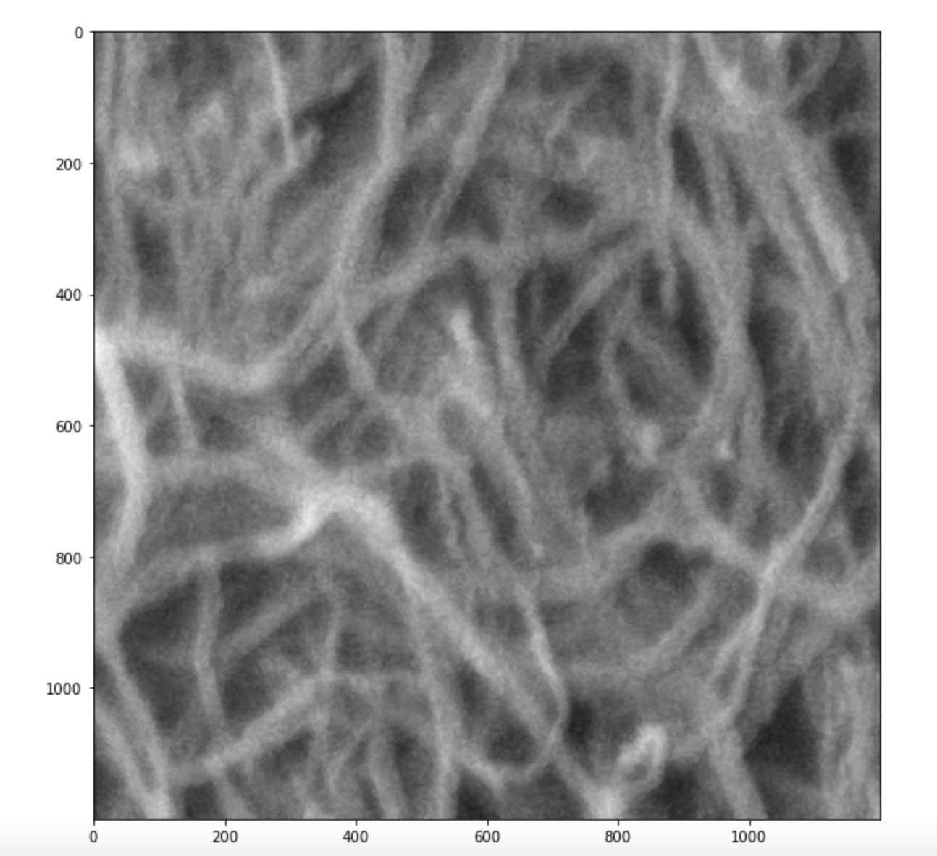
ESDR
ESPCN
LapSRN
FSRCNN

Slide 8
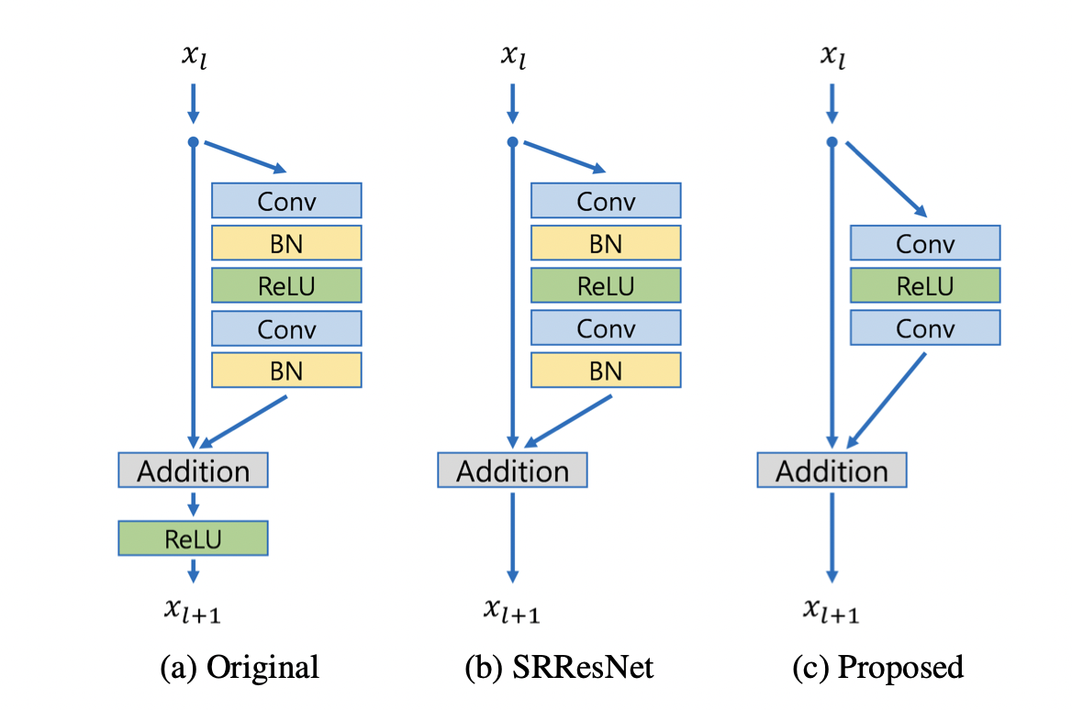
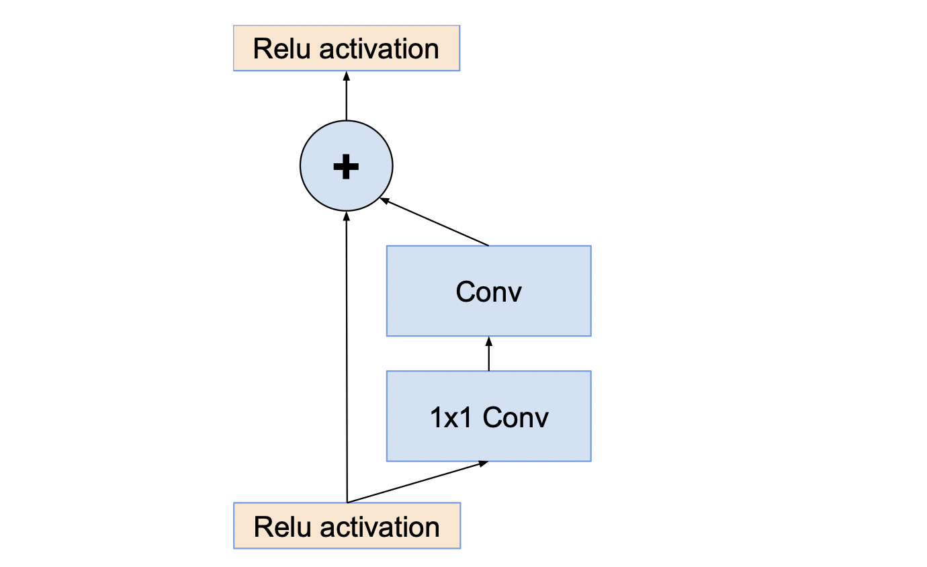
Computer Architecture (EDSR)
DIRECT Program
Fig 1: Comparison of residual blocks, applied proposed
model in this project .
Fig 2: Residual connections within activation layer

Slide 9
DIRECT Program
Img-processing (Sharpen the edge area with automatically modifying contrast)
Enhance_details (Sharpen the edge area)
EDSR (less memory needed, slow but thoroughly restoration)
ESPCN(Fast but roughly restoration)
FSRCNN(Similar to ESPCN, fast with roughly restoration)
LapSCN (Medium time consuming and medium restoration)

Slide 10
Choice
DIRECT Program
Scanning electron microscopy (SEM) image will be our training object
Images will be categorized by using machine learning process(Neural network such as CNN) into different categories, such as good picture, ambiguity(low resolution), and picture with surface charge effect..etc
Employ packages (open CV, pillow, inpaint_biharmonic()…) to enhance image quality, sharpness…
User interface (UI): Web based, users can upload their SEM pictures and got a better image back (Optional functions identified by users.

Slide 11
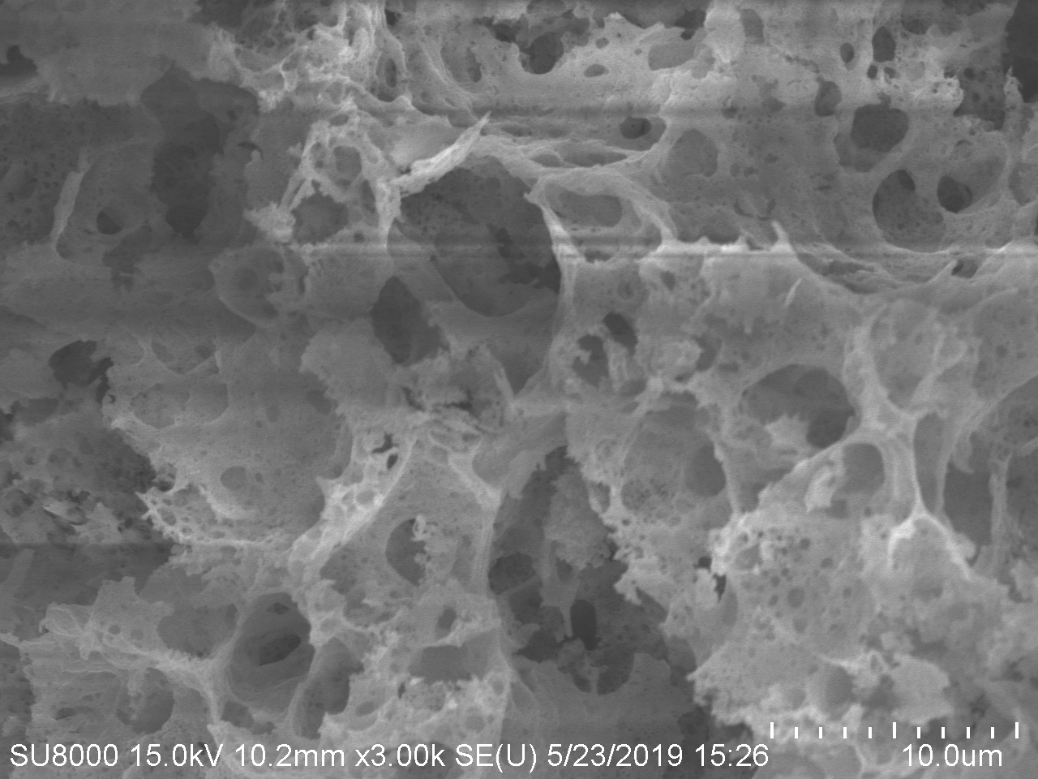
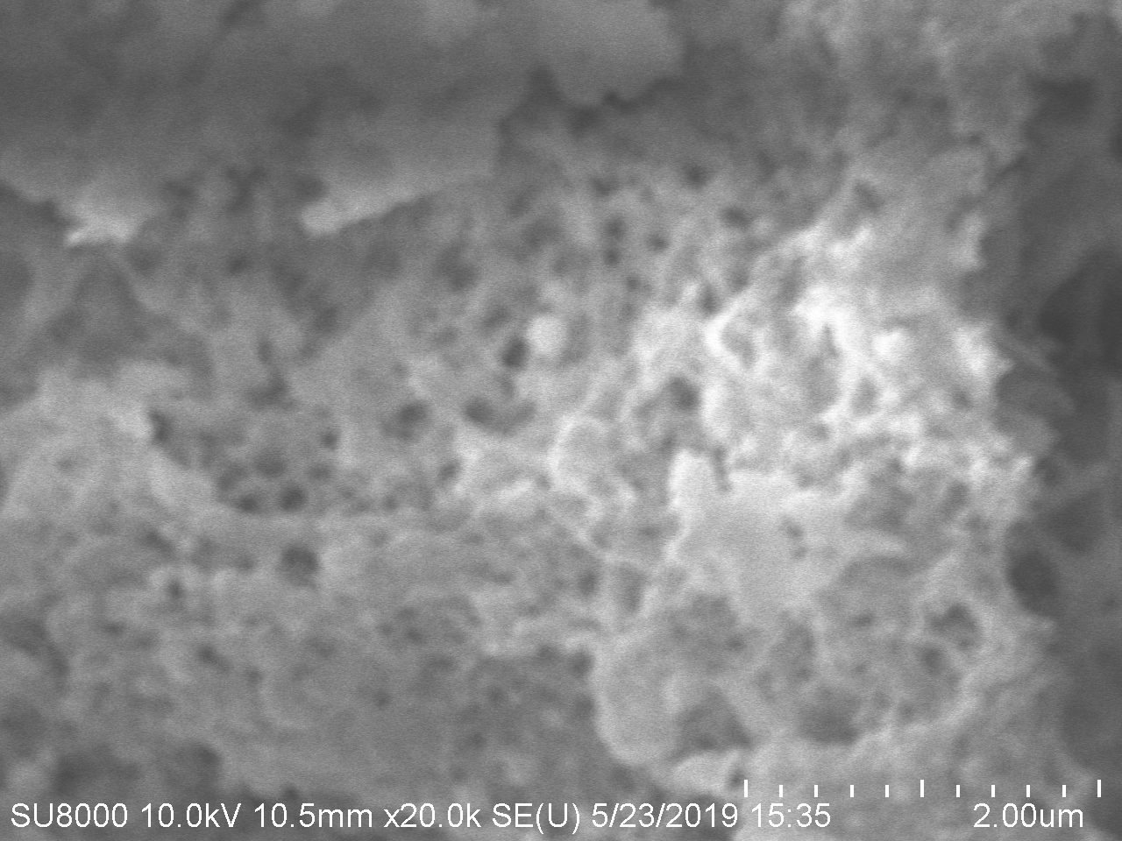
DIRECT Program
Fig 3: Surface charge
Fig 4: Blurred image

Slide 12
Appeal of choice
DIRECT Program
Particularly training from specific image type (ex: scanning microscope), increasing the precisely of the model
Selective area to repair or optimize the localized area.

Slide 13

Drawbacks of choice
DIRECT Program
Source is primary coming single type of image (SEM), may not be useful when applying to other type image (nanosheet or even in TEM or AFM with different background color)
Requirement of pre-processing before training, shrinking the image size of selected photo due to the time and memory requirement for training,.
Besides, the shrinking image is also suitable for image restoration for less computational resource needs,but sacrifice the high quality for image itself.
And if utilizing the raw photo (such as 960 * 1280, ) it’s time consuming process for training, classification and restoration.

Slide 14
Reference
DIRECT Program
1.Lim, Bee et al. “Enhanced Deep Residual Networks for Single Image Super-Resolution.” 2017 IEEE Conference on Computer Vision and Pattern Recognition Workshops (CVPRW) (2017): 1132-1140.
2. W. Shi, et al., "Real-Time Single Image and Video Super-Resolution Using an Efficient Sub-Pixel Convolutional Neural Network," in 2016 IEEE Conference on Computer Vision and Pattern Recognition (CVPR), Las Vegas, NV, USA, 2016 pp. 1874-1883
3.Dong, Chao et al. “Accelerating the Super-Resolution Convolutional Neural Network.” ECCV(2016).
4. Lai, W.-S., Huang, J.-B., Ahuja, N., and Yang, M.-H., “Fast and Accurate Image Super-Resolution with Deep Laplacian Pyramid Networks
5. Szegedy, C., Ioffe, S., Vanhoucke, V., and Alemi, A., “Inception-v4, Inception-ResNet and the Impact of Residual Connections on Learning”, <i>arXiv e-prints</i>, 2016.

